Slide 1
Syllabus (Unit-1)
Introduction to C++, C++ Standard Library, Illustrative Simple C++ Programs. Header Files, Namespaces, Application of object oriented programming.
Object Oriented Concepts, Introduction to Objects and Object Oriented Programming, Encapsulation, Polymorphism, Overloading, Inheritance, Abstract Classes, Accessifier (public/ protected/ private), Class Scope and Accessing Class Members, Controlling Access Function, Constant, Class Member, Structure and Class
1

Slide 2
Introduction to C++
C++ is an Object Oriented Language.
It was developed by Bjarne Stroustrup at AT&T’s Bell Laboratories.
Earlier it was called ‘C with Classes’ but later the name was changed to ‘C++’.
C++ is a superset of C, so that most C programs are also C++ programs.
2

Slide 3
Header Files in C++
A header file in C/C++ contains:
Function definitions
Data type definitions
Macros
Header files offer these features by importing them into your program with the help of a preprocessor directive called #include.
These preprocessor directives are responsible for instructing the C/C++ compiler that these files need to be processed before compilation.
4

Slide 4
…contd
Basically, header files are of 2 types:
Standard library header files
These are the pre-existing header files already available in the C/C++ compiler.
User-defined header files:
Header files can be designed by the user by saving the file name as .h extension.
There are a total of 49 header files in the Standard C++ Library
4

Slide 5
Header files in C/C++
#include<stdio.h>
Standard input-output header
Used to perform input and output operations in C like scanf() and printf().
#include<string.h>
String header
Perform string manipulation operations like strlen and strcpy.
#include<conio.h>
Console input-output header
Perform console input and console output operations like clrscr() to clear the screen and getch() to get the character from the keyboard.
5

Slide 6
Header files in C/C++
#include<stdlib.h>
Standard library header
Perform standard utility functions like dynamic memory allocation, using functions such as malloc() and calloc().
#include<math.h>
Math header
Perform mathematical operations like sqrt() and pow().
To obtain the square root and the power of a number respectively.
#include<ctype.h>
Character type header
Perform character type functions like isaplha() and isdigit().
To find whether the given character is an alphabet or a digit respectively.
#include<time.h>
Time header
Perform functions related to date and time like setdate() and getdate().
To modify the system date and get the CPU time respectively.
6

Slide 7
Header files in C/C++
#include<assert.h>
Assertion header
It is used in program assertion functions like assert().
To get an integer data type in C/C++ as a parameter which prints stderr only if the parameter passed is 0.
#include<locale.h>
Localization header
Perform localization functions like setlocale() and localeconv().
To set locale and get locale conventions respectively.
#include<signal.h>
Signal header
Perform signal handling functions like signal() and raise().
To install signal handler and to raise the signal in the program respectively
7

Slide 8
Header files in C/C++
#include<setjmp.h>
Jump header
Perform jump functions.
#include<stdarg.h>
Standard argument header
Perform standard argument functions like va_start and va_arg().
To indicate start of the variable-length argument list and to fetch the arguments from the variable-length argument list in the program respectively.
#include<errno.h>
Error handling header
Used to perform error handling operations like errno().
To indicate errors in the program by initially assigning the value of this function to 0 and then later changing it to indicate errors.

Slide 9
Header Files in C++
Following are some C++ header files which are not supported in C-
#inlcude<iostream>
Input Output Stream
Used as a stream of Input and Output.
#include<iomanip.h>
Input-Output Manipulation
Used to access set() and setprecision().
#include<fstream.h>
File stream
Used to control the data to read from a file as an input and data to write into the file as an output.

Slide 10
General form of a C++ program
// Program description #include directives
int main()
{
constant declarations variable declarations executable statements return 0;
}

Slide 11
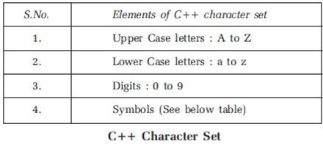
C++ Character Set
A C++ program is a collection of number of instructions written in a meaningful order.
Further, instructions are made up of keywords, variables, functions, objects etc.
All these uses C++ character set as shown below:

Slide 12
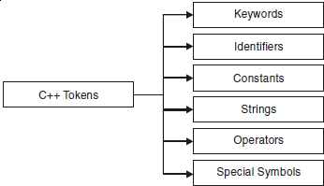
Tokens in C++
Smallest individual unit in a program is called Token.
C++ defined 6 types of tokens

Slide 13
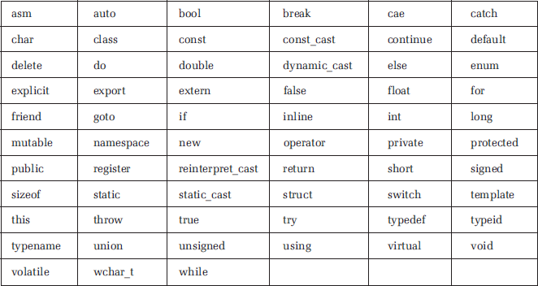
C++ Keywords
Each keyword has a predefined purpose in the language.
Keywords cannot be used as variable and constant names.
There are 63 keywords in C++ as follows:

Slide 14
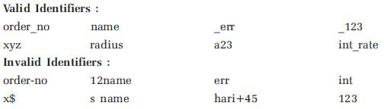
C++ identifiers
An identifier is a name for a variable, constant, function, etc.
It consists of a letter followed by any sequence of letters, digits, and underscores.
Rules for writing identifiers:
First letter must be an alphabet or underscore.
From second character onwards, any combination of digits, alphabets or underscores are allowed.
No other symbol except digits, alphabets or underscores is allowed.
Keywords cannot be used as identifiers.
Maximum length of identifier depends upon the compiler used.
Examples:

Slide 15
Variables
It is a named location in memory that is used to hold a value that can be modified in the program by the instruction.
All the variables must be declared before they can be used.
General form:
datatype variable_name [list];
Unlike C, C++ allows to declare variable anywhere in the program before its use.

Slide 16
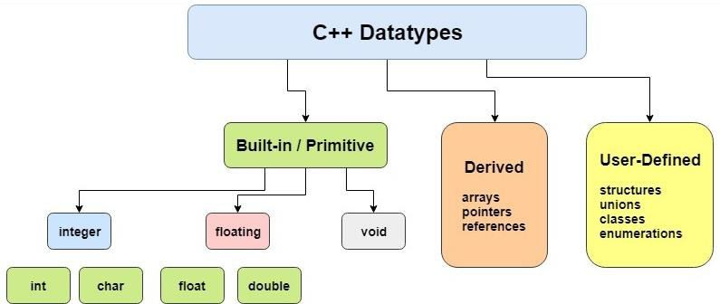
Data Types in C++

Slide 17
C++ comments
Comments are explanatory notes which are ignored by the compiler.
There are two ways to include comments in a program:
// A double slash marks the start of a
//single line comment.
/* A slash followed by an asterisk marks the start of a multiple line comment. It ends with an asterisk followed by a slash. */

Slide 18
Programming Style
C++ is a free-format language, which means that:
Extra blanks (spaces) or tabs before or after identifiers/operators are ignored.
Blank lines are ignored by the compiler just like comments.
Code can be indented in any way.
There can be more than one statement on a single line.
A single statement can continue over several lines.

Slide 19
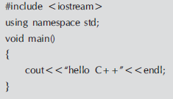
A simple C++ program

Slide 20

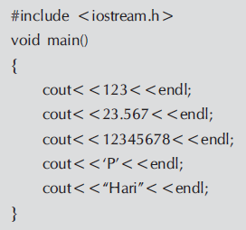
Output Operator
cout represents the standard output stream.
The operator << is called insertion operator or put to
operator.

Slide 21
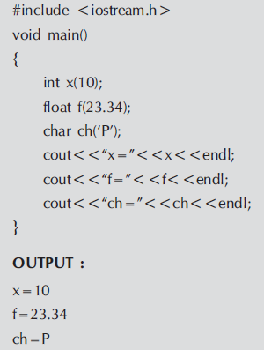
Example

Slide 22


Input Operator
cin represents the standard input stream.
The operator >> is called extraction operator or get from operator.

Slide 23
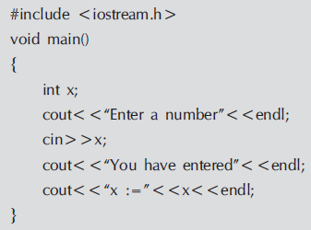
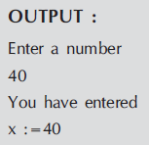
Example Program

Slide 24
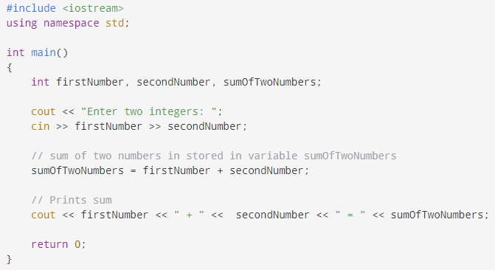
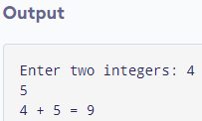
Program to add two numbers

Slide 25
Structure & Union
Structure and Union both are a collection of heterogeneous data elements.
struct book
{
char title[25];
char author[25]; int pages;
float price;
} book1, book2,book3;
union result
{
int marks; char grade; float percent;
};
26

Slide 26
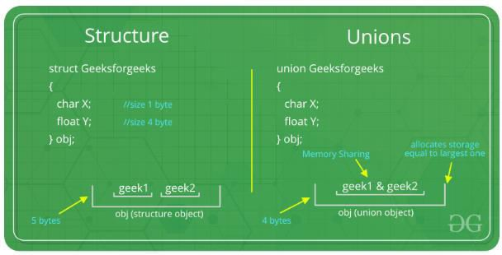

Slide 27
Difference between Structure & Union
Structure
A structure is defined with struct keyword.
All members of structure can be manipulated simultaneously.
Size of structure object is equal to the sum of individual sizes of member objects.
Structure members are allocated distinct memory locations.
Structures are not memory
efficient as compared to unions.
Union
A union is defined with union keyword.
The members of a union can be manipulated one at a time.
The size of a union object is equal to the size of largest member object.
Union members share common memory space for their exclusive usage.
Unions are considered memory efficient where members are not required to be accessed simultaneously.

Slide 28
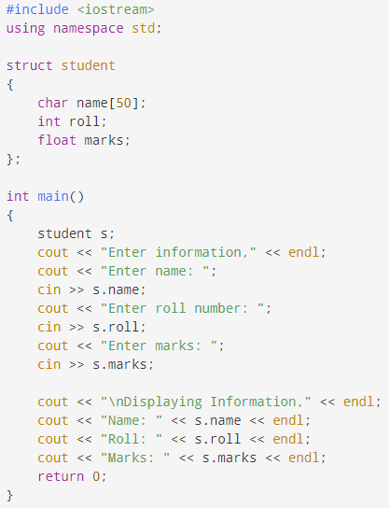
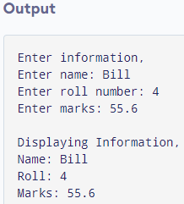
Store and Display information using Structure

Slide 29
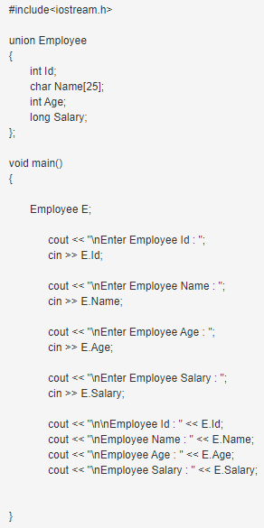
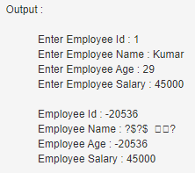

Slide 30
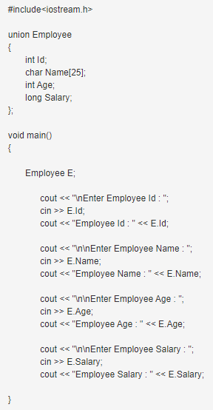
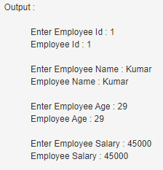

Slide 31
Enumerated data type
User defined data type which provide a way of attaching names to numbers.
enum automatically enumerates a list of words by assigning them values
0,1,2,….
enum shape{circle, square, triangle}; enum color{red, blue, green, yellow}; enum position{on, off};
We can use these as typenames also like: shape ellipse;
color background;
The integers values assigned to enumerators can also be over-ride. For example:
enum color{red,blue=4,green=8};
32 enum color{red=5,blue,green};

Slide 32
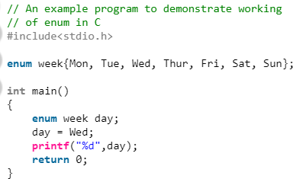
Output
2
33

Slide 33
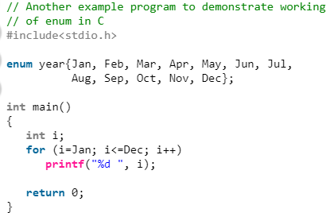


Slide 34
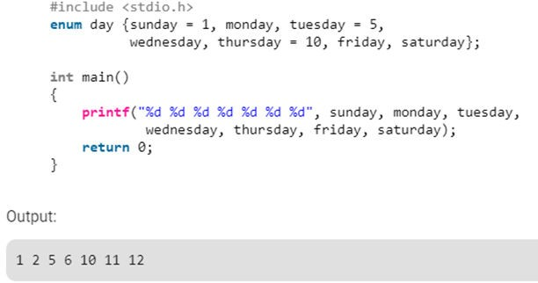

Slide 35
Derived data types
Arrays
Functions
Pointers
Reference

Slide 36
Pointers
int *ip; ip=&x;
*ip=10;
//int pointer
//address of x assigned to ip
//10 assigned to x through indirection
char * const ptr1=‘Good’; //constant pointer
Address of ptr1 cannot be modified.

Slide 37
Reference variables
Reference variable provides as alias name for a previously defined variable.
Syntax:
Data-type & reference-name = variable-name
eg.
float total=100; float & sum = total;
sum is the alternative name declared to represent total.
Any modification or assignment applied to either variable will
effect both.
Reference variable must be initialized at the time of declaration.

Slide 38
Memory Management Operators
New
To allocate memory dynamically.
Delete
To deallocate memory as and when required.
An object created using new will remain in existence until it is explicitly destroyed by delete.

Slide 39
Using NEW operator
General form of using new operator:
Pointer-variable = new data-type;
Eg.
P = new int; //p is a pointer of type int
Q = new float; //q is a pointer of type float
Here, p and q must be already declared.
Alternatively,
int *p = new int; float *q = new float;
*p = 25;
*q = 7.5;
Assigns 25 to newly created int object and 7.5 to float object.
OR
Pointer-variable = new data-type(value);
int *P = new int(25);
float *q = new float(7.5);

Slide 40
Using DELETE operator
delete pointer-variable;
delete p; delete q;

Slide 41
Manipulators
Endl
causes a linefeed to be inserted as new line character (“\n”)
Setw
Specifies a field width for printing the value of a variable and make
it right justified.

Slide 42
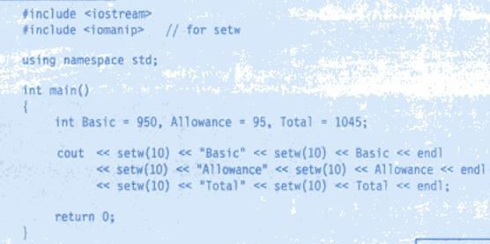


Slide 43
using namespace std
“using namespace std”
means we use the namespace named std.
“std” is an abbreviation for standard which means we use all the things with in “std” namespace.

Slide 44

Features of Object Oriented Programming in C++

Slide 45
Procedure Oriented Programming
Conventional programming such as FORTRAN, COBOL, C use procedure oriented programming.
The number of functions are written to accomplish various tasks.
Employs top down approach.
Large programs are divided in small programs known as functions.
Most functions share global data & data moves freely from one function to another.

Slide 46
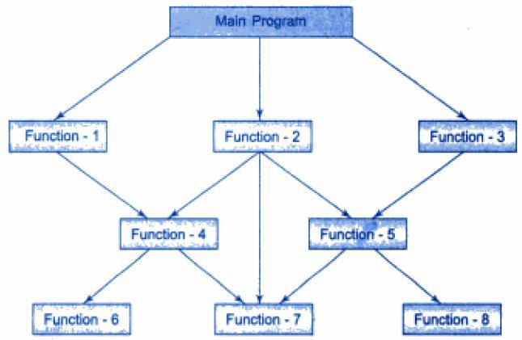
Structure of Procedure Oriented Programs

Slide 47
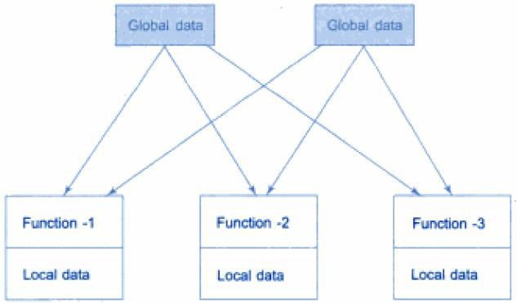
Relationship of Data and Functions in Procedural Programming

Slide 48
OBJECT ORIENTED PROGRAMMING
The object oriented approach is used to remove the flaws encountered in procedure oriented approach.
OOP treats data as a critical element & doesn’t allow it to flow freely around the system.
It ties data more closely to the functions that operate on it.
OOP allows decomposition of a problem into a number of entities known as objects and then builds data and functions around these objects.
The data of an object can be accessed only by the functions associated with that object, however, functions of one object can access the functions of other objects.

Slide 49
Features of OOP
Emphasis is on data rather than procedure.
Programs are decomposed into various entities known as objects.
Functions that operate on data of an object are tied together.
Data is hidden and cannot be accessed by external functions.
Objects may communicate with each other through functions.
New data and functions may be added easily as per necessity.
Follows bottom up approach in program design.
50

Slide 50
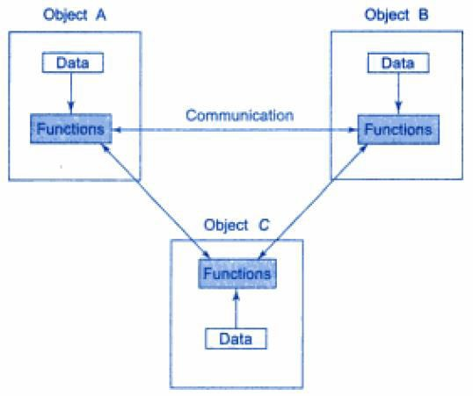
Organization of data and functions in OOP

Slide 51
Applications of OOP
Real Time Systems.
Simulation and Modeling.
Object oriented databases.
AI and Expert System.
Neural Networks and parallel programming.
Decision support and office automation systems etc.

Slide 52
FEATURES OF OOP
Various features of object oriented programming are:
Objects
Classes
Data Abstraction and Encapsulation
Inheritance
Polymorphism
Dynamic Binding
Message Passing

Slide 53
OBJECTS
Objects are the basic run time entities in an object oriented system.
They may represent a person, a place, a bank account or any other item that the program has to handle.
An object takes space in memory and have an associated address like a structure in C.
During execution, objects interacts by sending messages to each other.
Each object contains data and the code to manipulate the data.

Slide 54
REPRESENTING AN OBJECT
Object: STUDENT
DATA Name DOB Marks ………
FUNCTIONS Total Average Display ………..

Slide 55
CLASSES
A class is a collection of objects of similar types
e.g. mango, apple are objects of class Fruit
Classes are user defined data types and behaves like built-in types.
Any number of objects can be created after defining a class.
Syntax:
fruit mango;
Syntax for creating an object is similar to the syntax used in C to declare an integer object.
e.g. int num;
56

Slide 56
ENCAPSULATION
The wrapping up of data and functions into a single unit is called Encapsulation.
Data is not accessible to the outside world.
Only the functions that are wrapped in the class can access it.
It is called Data Hiding or Information Hiding

Slide 57
DATA ABSTRACTION
Representing essential details without background details is called Abstraction.
including
Classes are also known as Abstract Data Types (ADT).
The variables or attributes are called Data Members
because they hold information.
The functions that operate on these data are called
Methods or Member Functions.

Slide 58
INHERITANCE
The property by which objects of one class acquire the properties of objects of another class.
It supports Reusability.
A new class can be derived from the existing class by adding additional features to the existing class without modifying it.
The new class will have combined features of both the classes.

Slide 59











BIRD
Attributes Feathers Lays eggs
FLYING BIRD
Attributes
…………..
…………..
NON FLYING BIRD
Attributes
…………..
…………..
ROBIN
Attributes
…………..
…………..
SWALLOW
Attributes
…………..
…………..
PENGUIN
Attributes
…………..
…………..
KIWI
Attributes
…………..
…………..

Slide 60
TYPES OF INHERITANCE
Single Inheritance
Multiple Inheritance
Multilevel Inheritance
Hierarchical Inheritance
Hybrid Inheritance

Slide 61
POLYMORPHISM
Ability to take more than one form.
An operation may exhibit different behavior in different instances.
The behavior depends upon the types of data used in the operation.
Types of Polymorphism:
OPERATOR OVERLOADING
FUNCTION OVERLOADING

Slide 62
OPERATOR OVERLOADING
Process of making an operator to exhibit different behavior in different instances is called Operator Overloading.
E.g. Consider the addition operation:
for 2 numbers, the operation will generate a sum
If the operands are strings, the operation will produce a third
string by concatenation.

Slide 63
Function Overloading
Using a single function name to perform different types of tasks is called Function Overloading.
Known as Function Polymorphism.
All the functions having same name contains different argument lists.
Correct function to be invoked depends upon the number and type of arguments.

Slide 64

Shape Draw()
Circle Object Draw (circle)
Triangle Object Draw (triangle)
Square Object Draw (square)

Slide 65
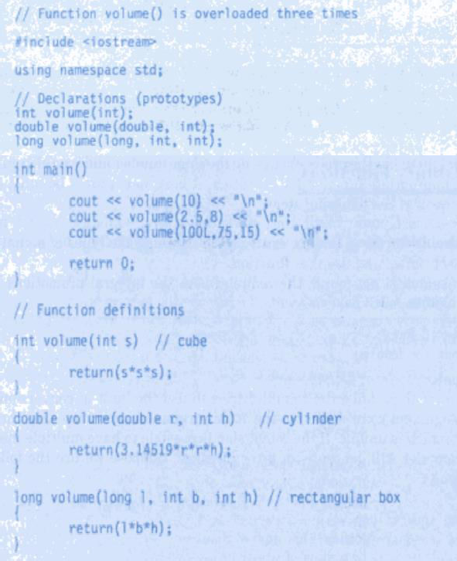

Slide 66
DYNAMIC BINDING
Also called Late Binding.
It means that the code associated with a given procedure call is not known until the time of call at run time.
Associated with Polymorphism and Inheritance

Slide 67
MESSAGE PASSING
Objects in Object Oriented Programming communicate with each other by sending and receiving information to and from other objects.
A message for an object is a request for the execution of a procedure.
Message passing involves specifying the name of the object, name of the function and information to be sent.
E.g. employee.salary(name);

Slide 68
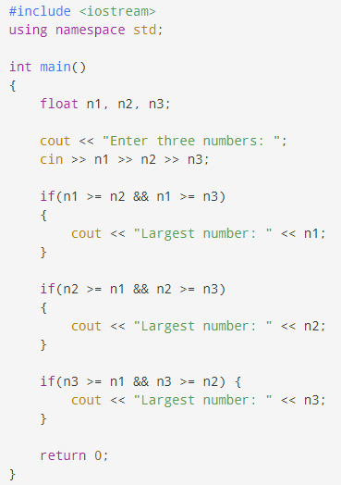
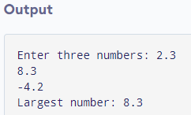
Program to find largest of three numbers

Slide 69
Scope Resolution Operator
The operator :: is called scope resolution operator.
It is used for two purposes.
For accessing global variables
Identifying class members to which class they belong
The scope of a variable extends from the point of its declaration till the end of the block containing the declaration.
The variable is local to that block.
If a global variable also exists with same name as the local variable, then local variable will be called by default within that block.
Scope resolution operator helps to access the global variable inside the block.
Syntax: :: variable-name
70

Slide 70
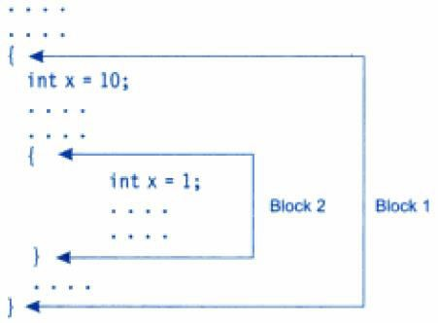
Scope Resolution Operator

Slide 71
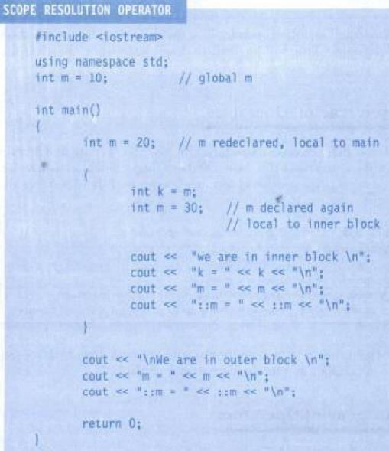
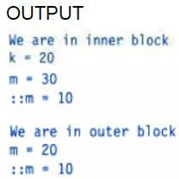

Slide 72

Functions in C++
A function is a block of code that performs a specific task.
There are two types of functions:
Standard library functions (Predefined in C++)
User-defined function ( Created by users)
Basic Syntax:
return-type: suggests what function will return
function-name: name of the function
Parameters: variables to hold values of arguments passed while function is called. A function may or may not contain parameters.
Function body: part where the code statements are written

Slide 73

Declaring, Defining and Calling a function
A function declaration tells the compiler about a function's
name, return type, and parameters.
Syntax:
A function definition provides the actual body of the function.
Syntax:
To use a function, we have to call or invoke that function.
When a program calls a function, program control is transferred
to the called function.
A called function performs defined task and when it’s return statement is executed or when its function-ending closing brace is reached, it returns program control back to the calling program.

Slide 74
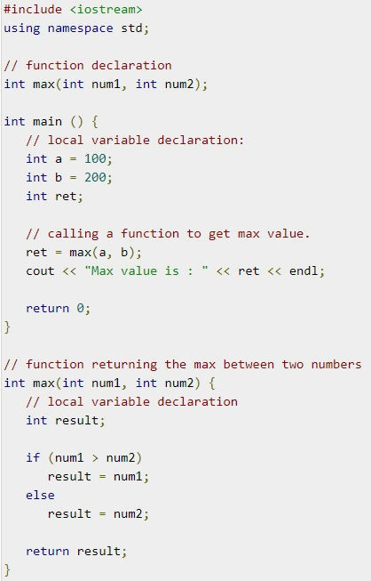


Slide 75
Inline Functions
When a function is called it performs a series of instructions:
Jumping to the function
Saving registers
Pushing arguments into stack
Returning to calling function
This might be an overhead if function is small.
Inline functions can to be used as a solution for this.

Slide 76
Inline Functions
It is a function that is expanded in line when it is invoked.
The compiler replaces the function call with corresponding function code.
Syntax:
inline function-header
{
function body
}
Eg.
inline double cube(double a)
{
return (a*a*a);
}
It can by invoked by the statement like: c=cube(3.0);

Slide 77
All inline functions must be defined before they are called.
There are certain situations where inline expansion may not work:
For function returning values, if a loop, switch or goto exists.
For function not returning values, if a return statement exists.
If function contain static variables.
If inline functions are recursive.

Slide 78
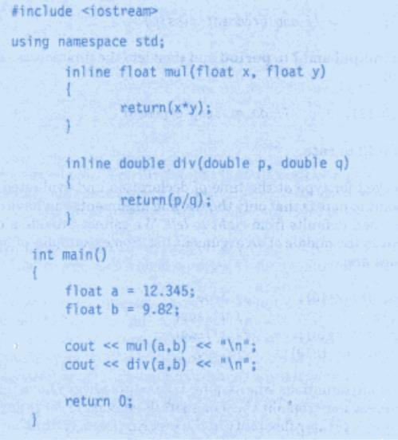
Program: Inline Function

Slide 79
Default Arguments
C++ allows to call a function without specifying all its arguments.
The function assigns a default value to the parameter which does not have a matching argument in the function call.
Default values are specified when the function is declared.

Slide 80
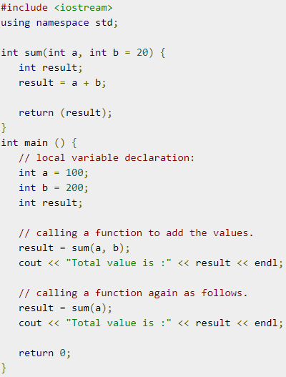


Slide 81
Classes
A class is a way to bind the data and its associated functions together.
General form of class declaration: class class_name
{
private:
variable declarations; function declarations;
public:
variable declarations; function declarations;
};
82

Slide 82
Visibility Labels
Private
Can be accessed from within the class.
Use of keyword is optional.
Class members are by default private.
Public
Can be accessed from outside the class also.
If both labels are missing, by default, all the members of the class are private.
82

Slide 83
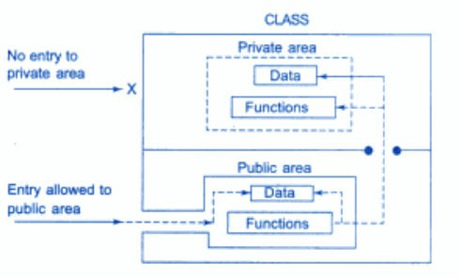
Data hiding in classes
83

Slide 84
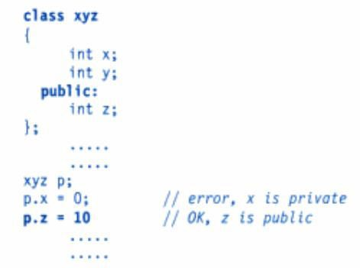
Accessing class members
General form:
object-name.function-name (actual-arguments);
Eg.
x.getdata(100,75.5); x.putdata();
84

Slide 85
Defining member functions
Member functions can be defined in two places:
Outside the class definition
Inside the class definition
85

Slide 86
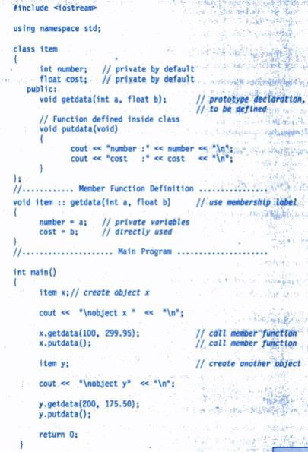
86

Slide 87
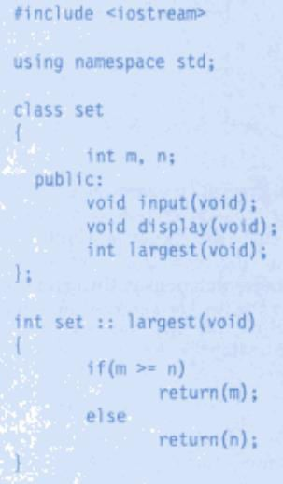
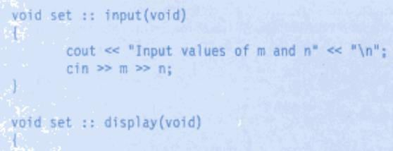
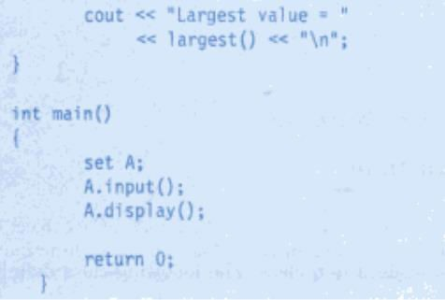
Nesting of Member Functions
87

Slide 88
Private Member Functions
A private member function can only be called by another function that is a member of its class.
An object of the class cannot call the private member function.
88

